Slide 1

THREE NUGGETS
Batch 12 , Group D

Slide 2
Today’s Presentation
Introduction
Marks Vs Knowledge
Smart People Can Do Smart Work
Andhra Pradesh Problems Ka Swadesh
Conclusion

Slide 3
Introduction
This is part of a Design Thinking (DT) project. The DT challenge is to raise the approval rating of the AP state government to 90%.
The steps We took to prepare these nuggets and this PowerPoint are we have taken a nugget and the information we heard or saw from people .

Slide 4

Marks Vs Knowledge
Insight: Marks and Grades are being too important than the knowledge.
Evidence: I saw people memorizing the theory without understanding.
Movie title: MARKS VS KNOWLEDGE
Poster: student mugging up for exam.

Slide 5
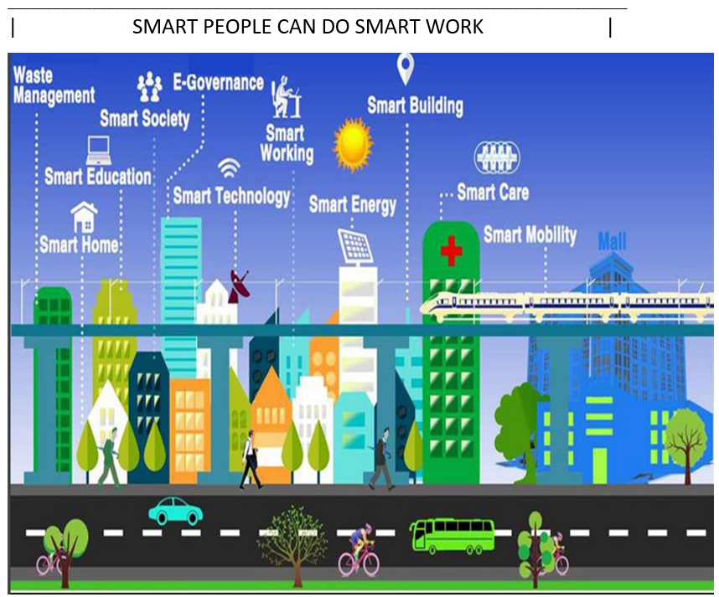
SMART PEOPLE CAN DO SMART WORK
INSIGHT: Smart Cities make everything inside them and around them SMART!
EVIDENCE:
I saw my friends who living in smart cities they getting smart education in this Pandemic.
My Professor’s are living in smart cities and using smart technology to teach us.
AP government is trying to build a smart city in Amaravati.
Movie-Style Title: SMART PEOPLE CAN DO SMART WORK
POSTER: The People Living In Smart City’s are enjoying by using Facilities.
Smart Cities make people lives better.

Slide 6

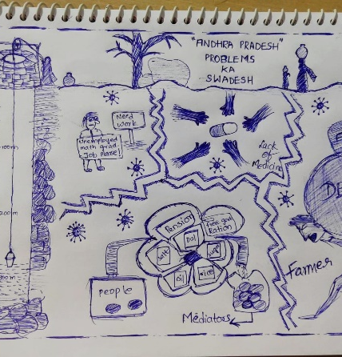
Andhra Pradesh Problems Ka Swadesh
INSIGHT: People are not getting proper facilities provided by the government
EVIDENCE: I heard that all the schemes provided by the government doesn’t reach the people
I saw that people are not getting proper facilities like ration on time.
Movie-Style Title: Andhra Pradesh Problems Ka Swadesh
POSTER:
This poster conveys that some people are not getting the proper facilties. and for some people the government was not providing the medicine in time. and the government is not providing the pension to the senior citizens. And unemployment is increased. And in some villages, there is no proper water, electricity and road facility and transportation

Slide 7
Conclusion
Our team learned
About the importance of insights in Design Thinking like the sensible way to solve a problem.
About the right way to define and document an insight in a nugget form.

Slide 8
Thank You…! 👍
From Batch – 12 Project – D

